Slide 1
Forge VR Explorer
Shawn Cross
Griffin Gonsalves
Paul Kwak

Slide 2
Main Purpose
Use Vrok.it and Forge API
Increase usability and add slightly more functionality
Upload CAD files
File conversion
Model viewing
VR with Google Cardboard

Slide 3
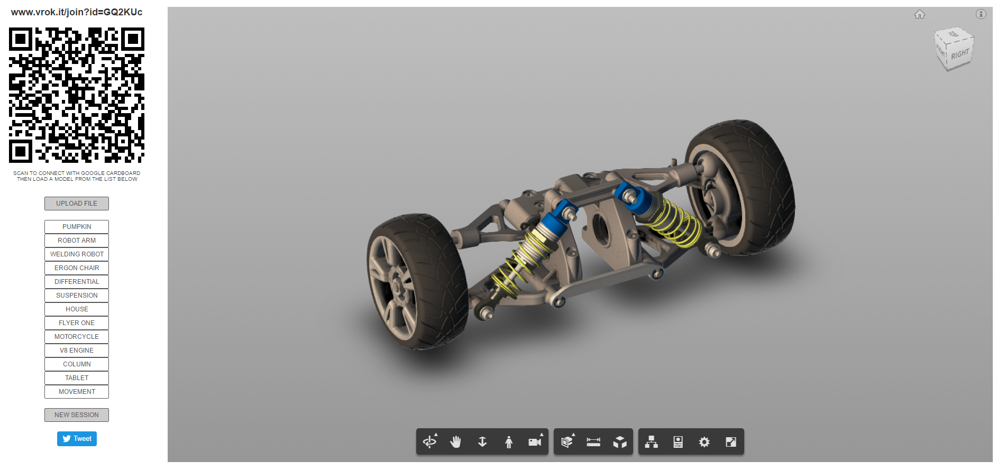

Slide 4
Overview
Requirements
Design
Week by week break down
Problems & Solutions
What’s next?

Slide 5
Requirements
Forge API Related
Model Viewing – Forge Viewer
Authentication
Data Management
Model Derivative
Non-related
File upload
Smartphone Connection
VR Device Support

Slide 6
Forge VR Explorer Functionality
User can choose a CAD model locally or through Data Management
3D model is shown through Forge Viewer
Connect to website with smartphone (via QR scanner)
Model can be viewed on phone normally or through Google Cardboard
Viewable model has interactivity

Slide 7
Software Interfaces

Slide 8
User Interfaces

Slide 9
Authentication Requirements
Security for users
Token created for users

Slide 10
Data Management Requirements
Users with files in A360 should be able to use in site
User gives website permission to use files
User can now choose file to view

Slide 11
Viewing VR Requirements
Model is viewable in VR headset (Google Cardboard)
High quality/size models will be hard to view
Models need some interactivity while user uses VR

Slide 12
Model View Requirements
User can see chosen model on website
Model cannot be too detailed or large
Where the website cannot run it
Model is displayed in Forge Viewer and is interactive

Slide 13
Model Derivative Requirements
Files user uploads will be converted to SVF files
Then the file will be displayed on viewer
Should notify user of any failures

Slide 14
File Upload Requirements
User can upload files
Through local machine
Or A360 (Data Management API)
Failures will be reported
Unsuccessful upload
Too large
File will be displayed on list of usable models

Slide 15
Smartphone Connection Requirements
Users connect phone to Vrok.it
So user can view model in VR environment
Users device must have QR scanner and internet
Phone should connect to site via QR scan

Slide 16
Authentication Design
2 Legged
3 Legged
For when site does not need permission based resources
Simple token exchange system for security
Dependent on Autodesk endpoints/system/servers
When users must verify permission for resources
Users verify permission after logging in
Token returned granting site access of resources
Dependent on Autodesk endpoints/system/servers
As well as user permission

Slide 17
Data Management Design
Relies on 3 Legged Data Authentication being completed
User accesses files stored in A360 to use
Data management returns those files

Slide 18
Viewing VR Design
Currently using Google Cardboard’s application
Android WebView inside the application (WebGL)
This allows for VR viewing of models on the site loaded by the QR scanner
Dependent on user having
Google Cardboard hardware
Google Cardboard application
Android Device Lollipop+

Slide 19
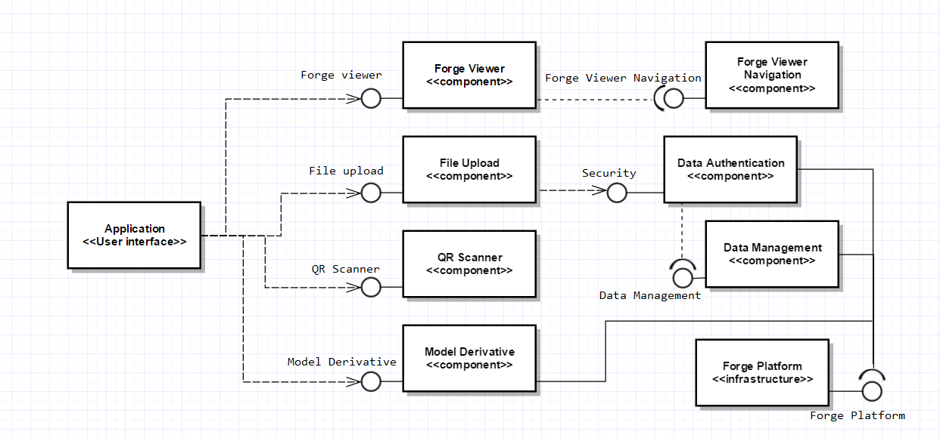
Website Interface
NEW interface
Focus on positive user experience
Needs to have:
Forge Viewer
File Upload
QR code
Model Derivative
Information and basic site content

Slide 20
Model View Design
Forge Large Model Viewer
Uses WebGL
Renders SVF model on webpage
Model is interactive
Components
Main view window
Listed Models
Viewer Controls
Model viewer navigation
Mobile Viewer

Slide 21
Model Derivative Design (File Conversion)
Uploaded files (local or not) sent
API accepts CAD files
Failure is notified to user
Success results in converted SVF file

Slide 22
Local File Upload Design
Select files on local machine
Site verifies file type
Conversion to SVF type
Returns success/failure
Components
Local Upload button
File selection
File type verification
File size verification
File conversion

Slide 23
Non Local File Upload Design
Login to Autodesk account
Give site permissions
Directed to A360 for file selection
File type verification
File size verification
File conversion

Slide 24
Smartphone Connection Design
Assumptions
User has “smartphone”
User has internet access
User has QR scanner
Mobile device can access site with QR scanner
Components
QR code
Device connection
Device view

Slide 25
Week 3
Brainstorming ideas
Meeting with Patti
Another meeting with Patti and Jim
Intro to Vrok.it
Polygon reduction?
Potential VR reduction?
Began idea of what we were doing.
Nothing concrete…

Slide 26
Week 4
Problem statement assigned
However, project not refined enough
Another conference call with Patti
Working out more details
Got in contact with Vrok.it creator, Kean
Still not enough information to begin problem statement

Slide 27
Week 5
Had official meeting with Kean and Patti
Enough information to finish problem statement
More user focused
Increasing performance if possible, but not optimizing
Viewer, VR content added in
Requirements document work begins

Slide 28
Week 6
Hard to meet with client
Wanted Nels to join the next meeting
Help narrow scope more
Help convey capstone intentions as well
Unable to get question answered due to Autodesk event

Slide 29
Week 7
Requirements Document draft finished
Feedback received
Needed to be more descriptive
Needed to incorporate more APIs if possible
Able to contact Patti and setup meeting
Tech review and requirements document final coincide
Paul fell ill, low communication and contribution

Slide 30
Week 8
Tech reviews submitted
Not bad, could have used more time
Good way to understand more components
Meeting with Nels and Patti, no Jim however
Able to work out some more important details
Not able to talk about performance tweaking
Overall quite productive week

Slide 31
Week 9
Least productive week
Thanksgiving and travelling
Design Document due in the next week
Documentation hard to decipher
Not able to break down as a group
Final draft of requirements document finished out

Slide 32
Week 10
Lots of work conflict with other classes
Design document
Still issues figuring out the IEEE document
Talk with Kirsten and Nels helped
Got good work done on the document

Slide 33
Problems
Low communication with client
Not enough question on our side
Not enough time on theirs
Team work
Better planning
Better communication
Faster help seeking

Slide 34
Solutions
Client
More question asking
Weekly meetings with client?
Team
More planning
Delegation?
Weekly meetings
Seeking help sooner

Slide 35
What’s next?
Start using API’s and Vrok.it!
Actual code implementation?
Might need to work out a couple details like…
Website hosting
Work load break up
Reports to Patti about API usage?

